Slide 1

Rheumatoid Arthritis Management Model: Summary Document
May 17, 2019

Slide 2
ART Model: Table of Content
# | Item | Page
1 | Background | 3
2 | Executive summary | 4
3 | Model Business Context and Goal | 5
4 | Data Scope and Details | 8
5 | Model Performance and Results | 10
6 | Model Features: EDA and Data Transformation | 13
7 | Conclusion | 19

Slide 3
ART Model: Background
Updates to the Model Since Last Review
Excluded data between January 2018 and December 2018. This avoids data leakage.
Added additional sources of data (11 new features)
ADM – Claim Types, Chronic Conditions Indicator, Provider Network Information
EDW - Provider Gap Ratio, Provider Program Indicator
Pulled data from time period: January 2017 to December 2017
Changed the approach for imputation

Slide 4
ART Model: Executive Summary
Business Understanding and Modeling Goal:
Predict which adults diagnosed with rheumatoid arthritis (RA) qualified for measure in a given year will not be dispensed at least one ambulatory prescription for a disease-modifying anti-rheumatic drug (DMARD) by end of reporting period.
Key Takeaways:
Attained 0.82 AUC to predict member compliance.
Top predictors: prior compliance, costs from Rx, lab tests, age, gender, living well indicator, product network indicator, Number of PCP visits, Risk scores.
Data Summary:
Data | Total Count | Positive | Negative | Positive Rate
Master Dataset | 1940 | 1316 | 624 | 68%
Training Set | 1359 | 922 | 437 | 68%
Testing Set | 581 | 394 | 187 | 68%
Data transformation and features:
Feature Engineering | Categorical | Numeric | Transformation Example
Demographics | 6 |  | One hot coding
Diagnosis | 3 |  | One hot coding
Procedures | 19 |  | One hot coding
Prescription | 101 |  | One hot coding
Lab |  | 200 | Rx cost statistics
Insurance | 15 |  | One hot coding
Model Performance:
Target | AUC | Accuracy | F1 | Kappa
Compliance | 0.82 | 0.78 | 0.79 | 0.51

Slide 5
ART Model: Table of Content
# | Item | Page
1 | Background | 3
2 | Executive summary | 4
3 | Model Business Context and Goal | 5
4 | Data Scope and Details | 8
5 | Model Performance and Results | 10
6 | Model Features: EDA and Data Transformation | 13
7 | Conclusion | 19

Slide 6
ART Model: Business Context and Goals
The Model:
Business Goal:
Predict which adults diagnosed with rheumatoid arthritis (RA) qualified for measure in a given year will not be dispensed at least one ambulatory prescription for a disease-modifying anti-rheumatic drug (DMARD) by end of reporting period
Data Preparation: Included data sources with clinical information to understand member condition as comprehensively as possible
Feature Engineering: Transformed raw data and individual attributes into meaningful features (demographics, pharmacy, lab, diagnosis, etc.)
Model Building: Evaluated various algorithms to determine model with best predictive power
Business Imperatives:
Improve compliance for current reporting year
Develop “clinical understanding” of given Medicare member
Determine new means of engagement – e.g., timing, frequency
[Develop Medicare provider behavioral patterns – need historical data]

Slide 7
ART Model: Table of Content
# | Item | Page
1 | Background | 3
2 | Executive summary | 4
3 | Model Business Context and Goal | 5
4 | Data Scope and Details | 8
5 | Model Performance and Results | 10
6 | Model Features: EDA and Data Transformation | 13
7 | Conclusion | 19

Slide 8
ART Model: Data Scope and Detail
Date parameters
Data Range: January 2017 to December 2017
Target definition:
- Qualified Members' Compliance as of December 2018
- Medicare population
Data quality
400 features derived from 50 raw columns
1940 members qualified for this measure in 2018
Imputation for numerical variables: imputed with median
Imputation for categorical variables:
- Impute with 0 where relevant (e.g.: ICD, NDC class, claim counts)
- Impute remaining with another category: “UNK” (e.g.: lab tests, compliance history)
Data | Row Count | Positive | Negative | Positive Rate
Master Dataset | 1940 | 1316 | 624 | 68%
Training Set | 1359 | 922 | 437 | 68%
Testing Set | 581 | 394 | 187 | 68%

Slide 9
ART Model: Table of Content
# | Item | Page
1 | Background | 3
2 | Executive summary | 4
3 | Model Business Context and Goal | 5
4 | Data Scope and Details | 8
5 | Model Performance and Results | 10
6 | Model Features: EDA and Data Transformation | 13
7 | Conclusion | 19

Slide 10
ART Model: Methodology Utilized
Algorithm | AUC (train) | AUC (test) | Remarks
Decision Tree | 0.83 | 0.78 | 3-fold cross validation (CV)
Random Forest (RF) RF hyperparameter tuning | 0.96 0.90 | 0.80 0.81 | 3-fold CV, Tuned: Number of variables randomly sampled at each split
Gradient Boosted Machine (GBM) GBM hyperparameter tuning | 0.85 0.86 | 0.81 0.82 | 3-fold CV; parameters tuned: no. of trees, depth, shrinkage, min. observations per node

Slide 11
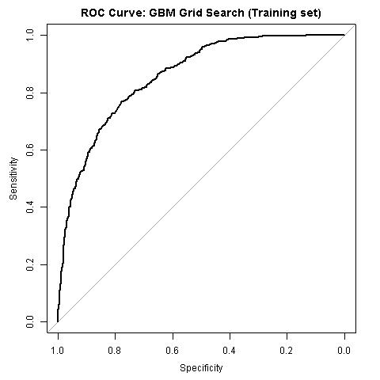
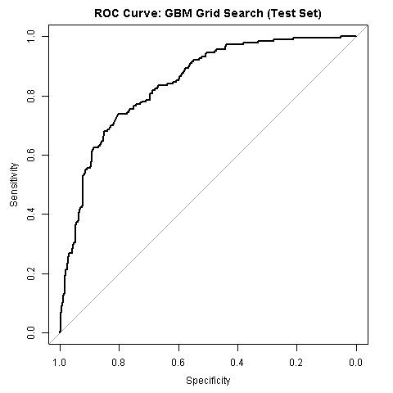
ART Model: Performance
ROC Curves
Key Takeaways:
The best performing model: Gradient Boosted Machine with grid search (hyperparameter tuning: total 108 models)
AUC: 0.82 (test set), 0.86 (training set)

Slide 12
ART Model: Table of Content
# | Item | Page
1 | Background | 3
2 | Executive summary | 4
3 | Model Business Context and Goal | 5
4 | Data Scope and Details | 8
5 | Model Performance and Results | 10
6 | Model Features: EDA and Data Transformation | 13
7 | Conclusion | 19

Slide 13
ART Model: Feature Engineering
Feature Engineering | Categorical | Numeric | Transformation Example
Demographics | 6 |  | Demographic variables: age, age stratification, gender, ethnicity, marital status, household income, county code were included
Diagnosis codes (ICD10) | 3 |  | One hot encoding : Value in column 'ICD_M08' is 1 for a member: M1 if ICD M08 was present at least once for M1 in the pharmacy table, else it is 0
Procedure codes (HCPCS) | 19 |  | One hot encoding : Value in column 'HCPCS_J9310' is 1 for a member: M1 if HCPCS J9310 was present at least once for M1 in the pharmacy table, else it is 0
Prescription/Pharmacy Drug Classes (derived from NDC codes) | 101 |  | One hot encoding : Drug class is extracted from first 5 digits of NDC- present in pharmacy table. Value in column 'NDC_00004' is 1 for a member: M1 if drug class 00004 was present at least once for M1 in the pharmacy table, else it is 0
Costs from pharmacy table |  | 240 | Various costs have been taken from pharmacy table for computation: min, max, mean, standard deviation, variance, sum
Other variables from pharmacy table: dose indicator, type of dispensing entity, severity, level of contingent therapy | 19 |  | One hot encoding for each variable
Lab Following test were included: 1. Rheumatoid Factor 2. Sedimentation Rate 3. Uric acid 4. Bone isoenzyme 5. Cyclic citrullinated peptide | 5 |  | One hot encoding : For each lab test result, the member can have three levels: High = H, Low = L, Normal = N- in lab table. This is how the variables are created for master table, for a member M1. If in lab results for M1, in lab table, at least one 'H' is present for test Rheumatoid, then for variable 'RF_lab_level' in master table , the value is = 2 for member M1 in master table. Else, if M1 has level 'L' in lab table, then value of variable 'RF_lab_level' is 1, else if M1 has at least one 'N' in lab table, then value of variable 'RF_lab_level' in master table is 0
Notes:
We gathered features from these sources

Slide 14
ART Model: Top 20 Features
Notes:
As expected, compliance history is the top predictor
Feature engineering for several top predictors
Notes:
* PBM amounts: represents cost of the product\service minus patient/other payer amounts

Slide 15
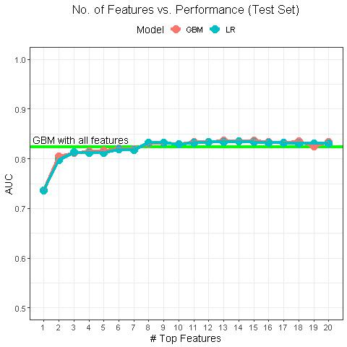
Feature Selection- Model Performance on Test Set
- Compare performances of Logistic Regression and Gradient Boosted Machine on test set
- Both models trained on top features given by Tuned Gradient Boosted Machine

Slide 16
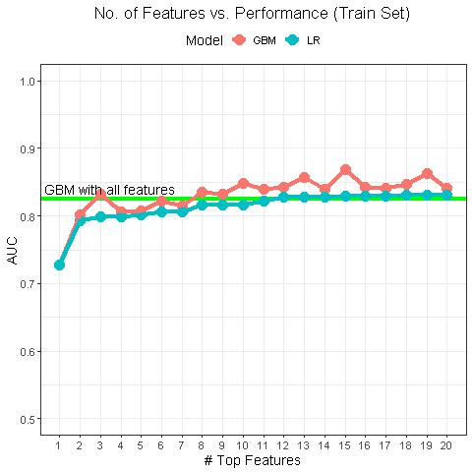
Feature Selection- Model Performance on Train Set
- Compare performances of Logistic Regression and Gradient Boosted Machine on train set
- Both models trained on top features given by Tuned Gradient Boosted Machine

Slide 17
Logistic Regression (LR) vs GBM
# Top Features | AUC Test (LR) | AUC Test (GBM) | AUC Train (LR) | AUC Train (GBM)
1 | 0.7358 | 0.7358 | 0.7271 | 0.7271
2 | 0.7991 | 0.8126 | 0.7946 | 0.8299
3 | 0.812 | 0.8149 | 0.799 | 0.8049
4 | 0.8107 | 0.8157 | 0.8001 | 0.8226
5 | 0.8107 | 0.8197 | 0.8001 | 0.8187
6 | 0.8251 | 0.8264 | 0.8208 | 0.846
7 | 0.8253 | 0.8245 | 0.8203 | 0.8384
8 | 0.825 | 0.823 | 0.8208 | 0.8364
9 | 0.8293 | 0.8221 | 0.8248 | 0.8309
10 | 0.8264 | 0.8262 | 0.8276 | 0.8311
11 | 0.7358 | 0.7358 | 0.7452 | 0.8453
12 | 0.7991 | 0.8126 | 0.7892 | 0.8563
13 | 0.812 | 0.8368 | 0.7773 | 0.8589
14 | 0.8346 | 0.8347 | 0.8028 | 0.8299
15 | 0.8132 | 0.8211 | 0.8062 | 0.8562
16 | 0.8121 | 0.8211 | 0.8274 | 0.8688
17 | 0.8218 | 0.8311 | 0.8163 | 0.8689
18 | 0.8026 | 0.8182 | 0.8173 | 0.8588
19 | 0.8146 | 0.8217 | 0.8193 | 0.8582
20 | 0.8046 | 0.8261 | 0.8129 | 0.84662

Slide 18
ART Model: Table of Content
# | Item | Page
1 | Background | 3
2 | Executive summary | 4
3 | Model Business Context and Goal | 5
4 | Data Scope and Details | 8
5 | Model Performance and Results | 10
6 | Model Features: EDA and Data Transformation | 13
7 | Conclusion | 19

Slide 19
ART Model: Concluding Remarks
Conclusion:
Data source: The current modeling process leverages all the available data sources, including demographic data, pharmacy data, diagnosis and procedure codes, lab data, etc.
There are 1940 members that qualify for this measure in December 2018.
The data engineering process produces 433 features that were derived from around 50 raw columns in the database.
The features contain: various dollar amount from claims, one-hot coding (for Dx, Rx, procedure codes), statistical metrics, lab data, provider information, demographic data.
We also leveraged our in-house clinical and healthcare knowledge to harness the lab data, procedures and diagnosis codes, NDC and GPI codes (including drug class, drug strength and dosage).
The best model performance reached 0.82 on test set.
O.6322
AUC
Specificity

Slide 20
Thank you
Shitang Patel
Director
shitang.patel@citiustech.com

Slide 21
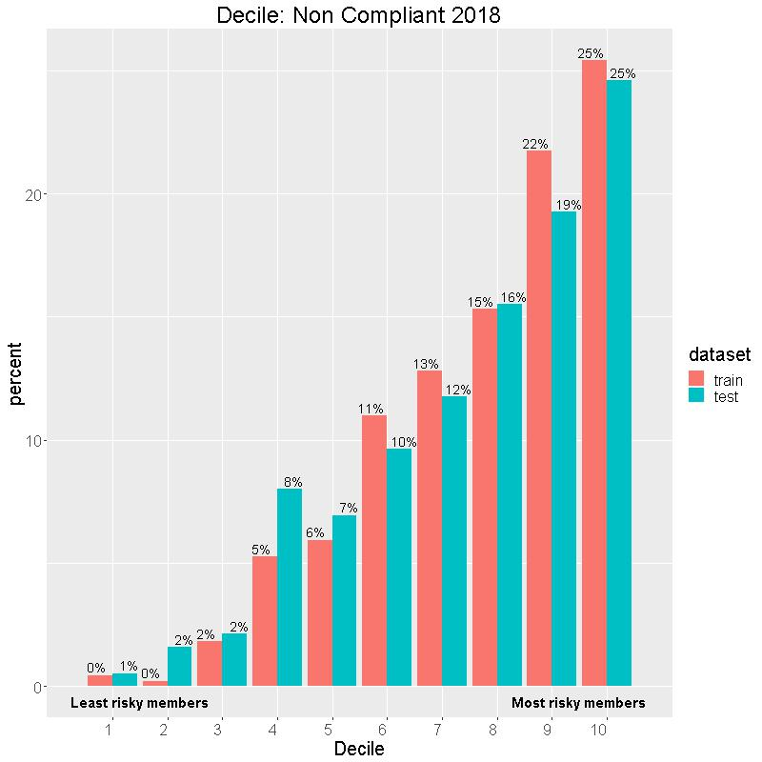
Non Compliance (2018): Train vs Test data
Notes:
Deciles are based on threshold parameter of the model
Given the % of population, how many are captured, and how many fail to comply
On left side is least risky members, and right side shows most risky members

